Slide 1
IMAGE SEGMENTATION DEEP LEARNING
SEGMENTING THE CARVANA IMAGE DATASET
BY
ERWIN SMITH
SEBASTIAN KOCH
YI-JIE YANG
SUMAN?

Slide 2
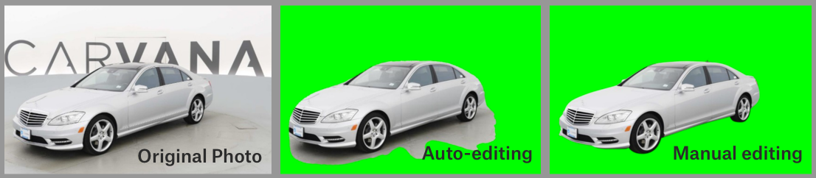
PROJECT SUMMARY:
For this project, we attempted the task of image segmentation through using a dataset from Kaggle; specifically the Carvana Masking Challenge.
The idea comes from the interests of knowing how to segment the object from the image. The datasets from the Carvana Image Masking Challenge is based on high quality car photos and the backgrounds of the images usually contain similar colors as cars.

Slide 3
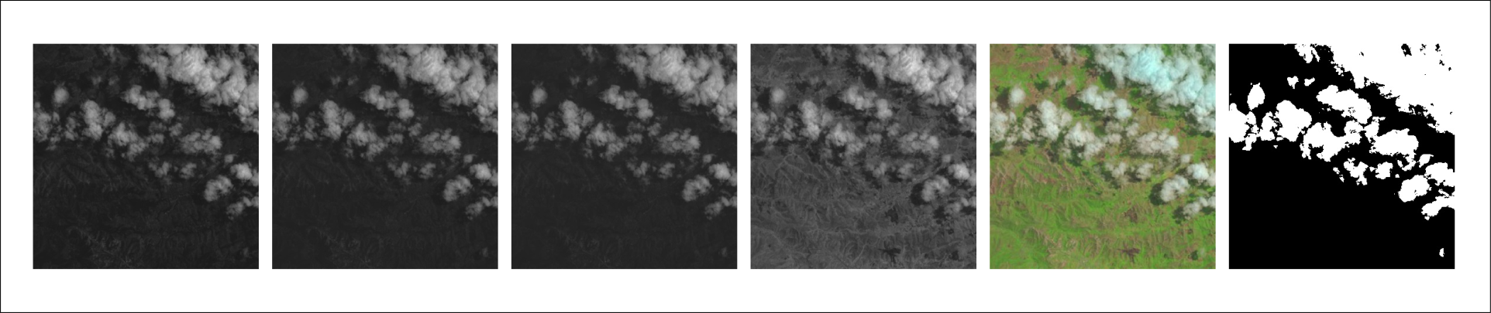
WHY THIS DATASET:
We first wanted to gain some basic understanding of image segmentation.
Car more easily separated from background – i.e. we have a somewhat more neutral background.
Once we have gained this basic understanding:
Perhaps then move on to more complex tasks like cloud segmentation.
This is a more complex task as there are more background features/colours.
A bit too complex for now – but someday!

Slide 4
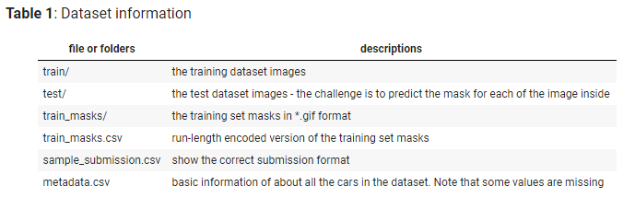
MORE ABOUT THE DATASET:
The dataset contains a large number of car images (as .jpg files). Each car has exactly 16 images, each one taken at different angles.
The dataset provided by the challenge was separated into different folders and files as the following table (information from the Kaggle challenge website)

Slide 5


TOOLS
Jupyter Notebook
GitHub
Google Colab
Carvana Masking Challenge Dataset from Kaggle.

Slide 6
ARCHITECTURE:
We first started with uploading the dataset and some image pre-processing and augmentation to generate a few more training examples.
We had to do this as the original dataset was a bit too large.
Therefore, we only used some of the training dataset and split this into a training and test set.
We then attempted to train our model using UNET (developed by Ronneberger et al.) .

Slide 7
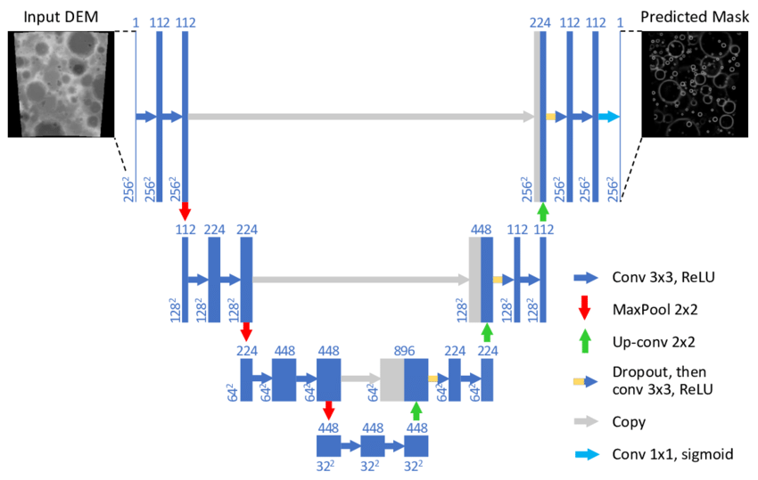
ARCHITECTURE (cont.):
This is a end-to-end fully convolutional network: it has no dense later = so as to accept images of any size.
This is especially useful for image segmentation tasks.
It works through repeated applications of convolutions, each followed by a rectified linear unit (ReLU) and max pooling (up-sampling).

Slide 8

ARCHITECTURE (cont.):
We then compiled our model by using the following standard elements:
Our loss function (as suggested by literature): a Sigmoid Activation + Cross-Entropy Loss (Why? =) the loss is computed for every CNN output vector component, independent of the other components.
This is how we attempted to measure our performance.

Slide 9
STORY:
We initially wanted to do image segmentation on a cloud dataset.
This may have been useful in many applications such as in agriculture.
We found this a bit too challenging as beginners.
We decided to first try something a bit simpler as practice.
This led us to the Carvana Image Segmentation Challenge.
We experienced quite some difficulty in training our model with some average accuracy.
We had some problems with your loss function.

Slide 10
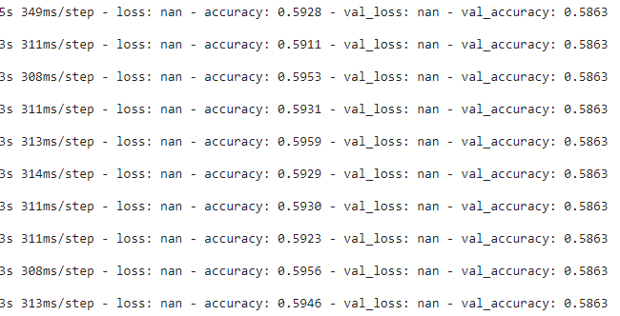
RESULTS:

Slide 11
WHAT IS MISSING?
We were unable to successfully define a loss function with some losses being represented as “NaN”.
We had some difficulties in representing the loss functions graphically as well.
We also had some difficulties in creating and testing some of our test data sets.

Slide 12
FUTURE WORK:
We hope to find a way of training our model successfully.
If we have a bit more time, perhaps we can do that.
(student and working life ☹)
Using image segmentation for estimating cloud cover – which may be a great application in many fields such as rain and related weather prediction!

Slide 13
THANK YOU!

